Slide 1
Milestone – III Classification of Traffic Signs
Using Convolutional Neural Network
Manikandan A
DA/DS – November 2024
30-05-2025

Slide 2
Objective
Split the dataset into training, validation, and testing sets for various evaluation.
Implement image augmentation to enhance model generalization and performance.
Develop 2 CNN models and evaluate their accuracy in classifying road signs into 30 distinct categories.
Predict the road sign class of unseen images from the test dataset with high accuracy.

Slide 3
Contents of the dataset
01
02
03
Train
Test
Training data with images classified under 30 classes starting from 0 to 29 (743 Files, 30 Folders)
Testing data with images classified under 30 classes starting from 0 to 29 (280 Files in 30 Folders)
Labels
The classes 0 to 29 and their respective sign names. Example 0 – Speed Limit (5KM/h)

Slide 4
Libraries used
import PIL
import glob
from tensorflow import keras
from tensorflow.keras import layers
from tensorflow.keras.regularizers import l2
from tensorflow.keras.models import Sequential
from keras.layers import Dense, Dropout, Flatten, Conv2D, MaxPool2D,
from sklearn.metrics import accuracy_score, precision_score, recall_score, f1_score, confusion_matrix, classification_report
from pathlib import Path
Import os
import tensorflow as tf
import matplotlib.pyplot as plt
import numpy as np
import pandas as pd
import seaborn as sns
import matplotlib.image as mpimg

Slide 5
01
Introduction - Collection
The dataset is downloaded and moved to the respective directory for the model to find the images with ease.
The folder names are changed in respective to their name as per the class id from the Labels excel sheet.

Slide 6
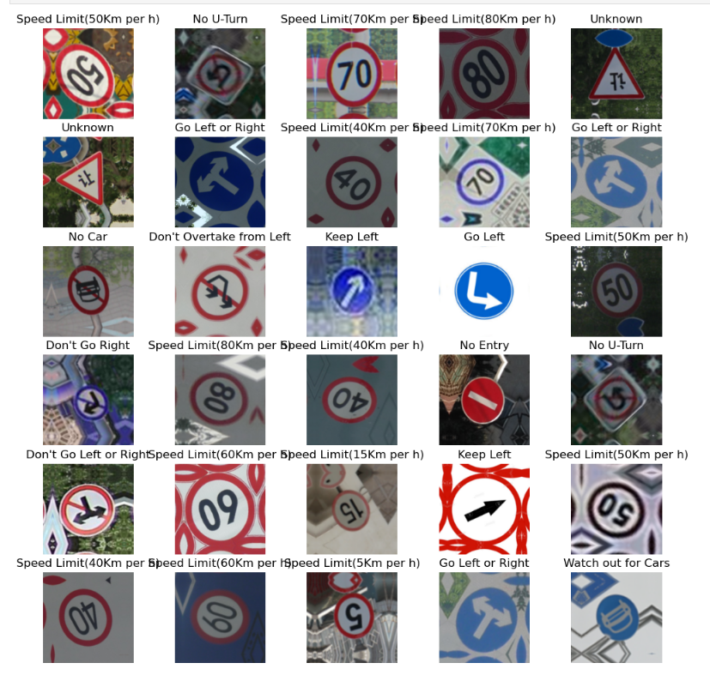
Understanding and Visualizing data
Don't Go Left
Don't Go Left or Right
Don't Go Right
Don't Go Straight
Don't Go straight or left
Don't Overtake from Left
Go Left
Go Left or Right
Go Right
Go Straight
Go Straight or right
Horn
Keep Left
Keep Right
No Car
No Stopping
No U-Turn
Roundabout Mandatory
Speed Limit(15Km per h)
Speed Limit(30Km per h)
Speed Limit(40Km per h)
Speed Limit(50Km per h)
Speed Limit(5Km per h)
Speed Limit(60Km per h)
Speed Limit(70Km per h)
Speed Limit(80Km per h)
Unknown
Watch out for Cars
No Entry
No Horn

Slide 7
Preprocessing
Resizing
Normalization
Data Optimization
batch_size = 32
img_height = 180
img_width = 180
num_classes = 30
These are the parameters set for the images before inserting them to the model.
The height and width of the image are set to 180 and the num_classes define the 30 different signs under which the images are classified.
Batch size as 32 represents the number of images processed at a time.
Normalization is done in order for the pixel of images to be in the range of 0 to 1.
model = Sequential([layers. preprocessing.Rescaling(1./255, input_shape=(img_height, img_width,3))])
1. – Example pixel value of an image
255 – Maximum pixel value of an image
3 – the number of standard colours in the image – Red, Blue and Green.
train_ds=
train_ds.cache().shuffle(1000).prefetch(buffer_size=Autotune)
val_ds=
val_ds.cache().prefetch(buffer_size=Autotune)
cache() to keep the dataset in memory for faster training.
shuffle() to randomize training samples each epoch.
prefetch() to load batches in the background while training.

Slide 8
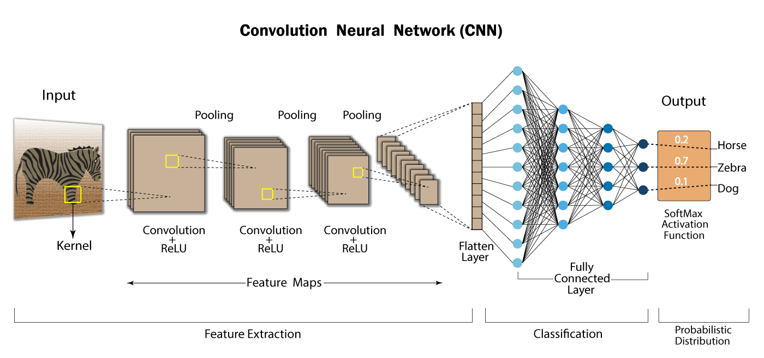
CNN Model 1 – Training and Validation
Model Initialization(Sequential, Rescaling, Parameters)
Convolutional Layer1(16 Kernels, 3*3 Filters, Same padding, ReLu)
PoolingLayer1(MaxPooling, size = 2*2)
Convolutional Layer2(32 Kernels, 3*3 Filters, Same padding, ReLu)
PoolingLayer2(MaxPooling, size = 2*2)
Convolutional Layer3(64 Kernels, 3*3 Filters, Same padding, ReLu)
PoolingLayer3(MaxPooling, size = 2*2)
Flatten
Fully connected Layer1(128, ReLu):
Fully connected Layer2(128, ReLu):
Output(Softmax)
Model Optimizer – Adam
Loss Function – SparseCategoricalCrossentropy
Total files – 743
Training(80%) - 595
Validation(20%) - 148
Epochs - 20
Accuracy achieved – 100%

Slide 9
Augmentor
Augmentor – A third party Library
Transformation applied – Rotation
Probability of rotation – 70%
Transformation rate – Give or take 10%
Samples added – 50 per class
File Directory – Output
Augmented Dataset
Total files – 2243
Training(80%) - 1795
Validation(20%) - 448
batch_size = 32
img_height = 180
img_width = 180
num_classes = 30

Slide 10
CNN Model 2 – Augmented data
Model Initialization(Sequential, Rescaling, Parameters)
Convolutional Layer1(16 Kernels, 3*3 Filters, Same padding, ReLu
PoolingLayer(MaxPooling, size = 2*2)
Convolutional Layer2(32 Kernels, 3*3 Filters, Same padding, ReLu
PoolingLayer(MaxPooling, size = 2*2)
Convolutional Layer3(64 Kernels, 3*3 Filters, Same padding, ReLu
PoolingLayer(MaxPooling, size = 2*2)
Convolutional Layer4(64 Kernels, 3*3 Filters, Same padding, ReLu
PoolingLayer(MaxPooling, size = 2*2), Dropout – 25%
Flatten
Fully connected Layer1(128, ReLu), Dropout – 25%, L2 Regularizer
Output(Softmax)
Model Optimizer – Adam
Loss Function – SparseCategoricalCrossentropy
Epochs - 40
Accuracy achieved – 98%

Slide 11
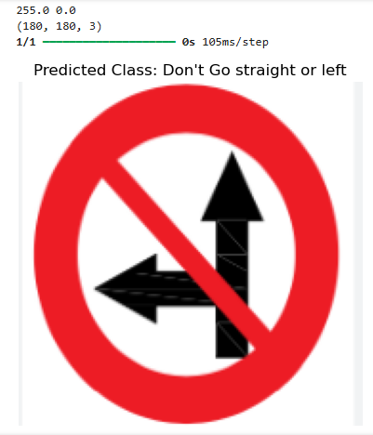
Prediction
Scores
Accuracy: 0.972972972972973
Precision: 0.977027027027027
Recall: 0.972972972972973
F1-score: 0.9730841230841231

Slide 12
Thank You!

